Slide 1
Welcome to CS 2323
Computer Architecture
Praveen Tammana
PhD: Univ. of Edinburgh
Postdoc: Princeton University

Slide 2
CA MS teams
Connect using Microsoft Teams
Team name: CA-CS2323
Channel: General
Will post
Course material, lecture videos, TA details
Assignments, quizzes, etc.
More channels to come..
Be active in the teams group
Help each other, ask questions

Slide 3
CA initial hiccups
Overlap with other courses?
Please de-register and take the course next year
Pre-requisites:
CS1353: Introduction to Data structure
ID1303: Introduction to Programming
If not done with both courses, please de-register
Any trouble accessing teams account?
Contact Vijay (vijay.chakry@cse.iith.ac.in)

Slide 4
Reference books
Mostly: Computer Organization and Design, The hardware/Software Interface
5th Edition (MIPS)
Authors:
David A. Patterson
Joh L. Hennessy
Optional read:
Computer Organization and Architecture, by Smriti Ranjan Sarangi

Slide 5
Course Component
Assignments:
Programming assignments
Periodic quizzes/Tutorials during class hours
Tentative scoring policy
Attendance: 10% (if issues in joining, please drop a mail before the class to the TAs, they will mark it)
Coding assignments: 60%, Quizzes/Tutorial: 30%
No final exam
Grading policy: >98 == A+, 92-98% = A, 88-92% = A-, 85-88 = B, 80—85 = B-, 75-80=C, 70-75 = C-, 50-70=D, <50=F, etc). For audit grade: 85% attendance is mandatory

Slide 6
Course topics & tentative timeline
Sep 1-7: Computer abstraction and technology
Sep 9-25: Instructions: Language of the computer
Sep 17: Assignment 1 start date
Sep 21-Oct 2: Arithmetic for Computers
Oct 5-16: The processor
Oct 5: Assignment 1 end-date
Oct 15: Assignment 2 start-date
Oct 19-30: Large and Fast: Exploiting Memory Hierarchy
Nov 2: Assignment 2 end-date
Nov 2-11: Parallel processors from Client to Cloud

Slide 7
Chapter 1
Computer Abstractions and Technology
Thanks to Authors & MK for the slides
Notes:
Our economy is becoming highly dependent on online services, computers, cloud, etc.
In this course, students learn about low-level details of computer that made all application built on top of it possible.

Slide 8
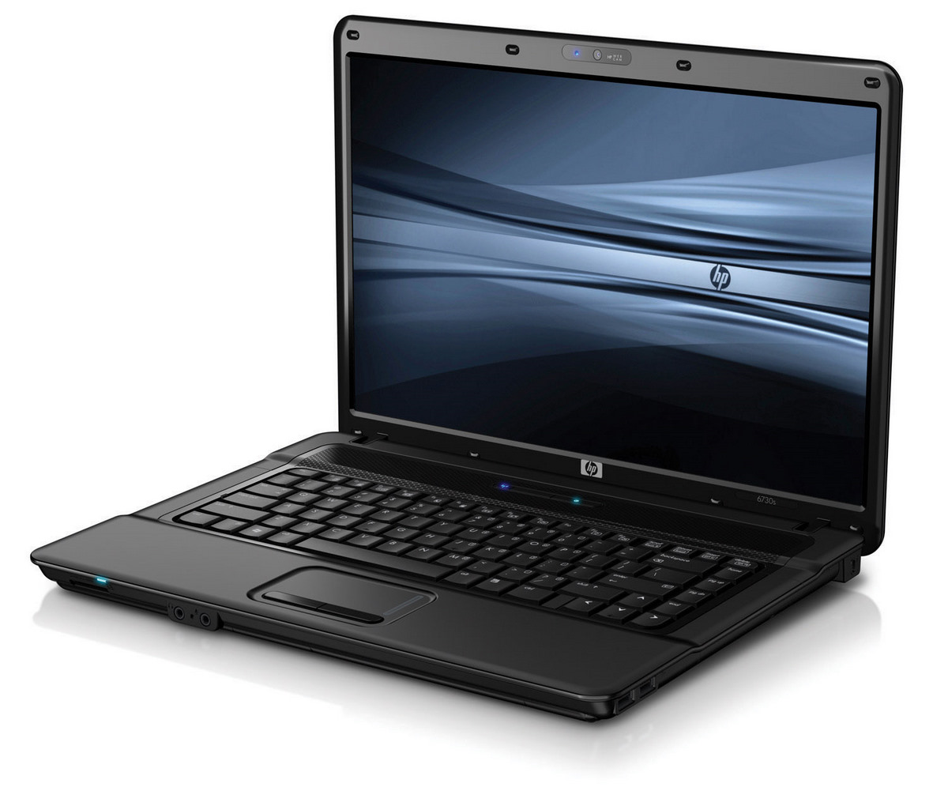


Classes of Computers
Desktop computers
General purpose, variety of software
Subject to cost/performance tradeoff
Server computers
Network based
Super computers: High capacity,
performance, reliability
Cloud computing: Range from
10’s of servers to 100K servers
(E.g., DCs built by Google, Amazon..)
Embedded computers
Hidden as components of systems
Stringent power/performance/cost constraints
Intel i3-35K, i5-50K, i7-80K (Rs)
Super computer: >100 crores, 1000’s of processors, Terabytes of memory
Notes:
Although a common set of hardware technologies is used in computers ranging from smart home appliances to cell phones to the largest supercomputers, these different applications have different design requirements and employ the core hardware technologies in different ways.
Desktop computers
- emphasize delivery of good performance to single users at low cost
- usually execute third-party software.
Intel I3-7 cost in Rs.
Servers are the modern form of what were once mainframes, minicomputers, and supercomputers, and are usually accessed only via a network.
- Servers are oriented to carrying large workloads - a single complex applications—usually a scientific or engineering application—or handling many small jobs, such as would occur in building a large Web server.
- In general, servers also place a greater emphasis on dependability, since a crash is usually more costly than it would be on a single-user desktop computer.
- Datacenter (DC) is a farm of servers that could be as large as 300 times cricket field.
Embedded computers: Widest range of apps and performance
includes microprocessors in cars
computers in television sets
Amazon echo, smart bulbs
processors that control modern airplane or cargoship
+ Personal mobile devices

Slide 9
The Computer Revolution
§1.1 Introduction
Progress in computer technology
Underpinned by Moore’s Law
Makes novel applications feasible
Computers in automobiles
Cell phones
Human genome project
World Wide Web
Search Engines
Computers are pervasive
Notes:
Moore's Law refers to Moore's perception that the number of transistors on a microchip doubles every two years, though the cost of computers is halved.
Each time the cost of computing improves by order of 10, the opportunities multiply.
Computers reduce pollution, improve fuel efficiency, air bag inflation to protect occupants in a crash
connects ½ of the population on planet from almost every where
The cost of computer equipment to map and analyze human DNA sequences was hundreds of millions of dollars, now it is significantly reduced and made once science fiction a reality. DNA sequencing, determines the order of nucleotides in a DNA strand, allows scientists to read the genetic code so they can study the normal versions of genes. After they know the order of nucleotides in normal and disease versions of a gene, they can identify which changes in the gene cause the disease.
Web has replaced libraries and news papers
Finding relevant information became increasingly important. It is a hardship to go without them
Clearly, all this technology is possible because of computers the we rely on every aspect of our society.
In this course you will learn the fundamentals of hardware/software of a computer that enable killer applications like glasses with augment reality, cashless society, and cars that can drive themselves is possible.

Slide 10
What You Will Learn
How programs are translated into the machine language
And how the hardware executes them
The hardware/software interface
What determines program performance
And how it can be improved
How hardware designers improve performance
What is parallel processing
Notes:
How are programs written in a high-level lang, such as C or Java translated into the language of the hardware, and the hardware execute those programs?
What is the interface between s/w and h/w? How s/w instruct hardware?
What determines a performance & how it can be improved? program -> machine language -> h/w executes the program!
What techniques h/w designers use to improve performance?
Reasons for moving from sequential processing to parallel processing?
Why one has to understand answers to these questions?
Without that improving program performance or evaluate what features make one computer better than another will be a complex process of trial and error!

Slide 11
The Processor Market
Notes:
Globally, devices and connections are growing faster (10 percent CAGR) than both the population (1.0 percent CAGR) and the Internet users (6 percent CAGR).
A growing number of M2M applications, such as smart meters, video surveillance, healthcare monitoring, transportation, and package or asset tracking, are contributing in a major way to the growth of devices and connections.
By 2023, M2M connections will be half or 50 percent of the total devices and connections.

Slide 12
Understanding Performance
Algorithm
Determines number of operations executed
Programming language, compiler, architecture
Determine number of machine instructions executed per operation
Processor and memory system
Determine how fast instructions are executed
I/O system (including OS)
Determines how fast I/O operations are executed
Notes:
Algorithm determines #operations
PL, comp, arch determine #machine instructions per operation
Processor and mem system determine how fast each instruction can be executed
I/O system determine how fast I/O operations are executed

Slide 13
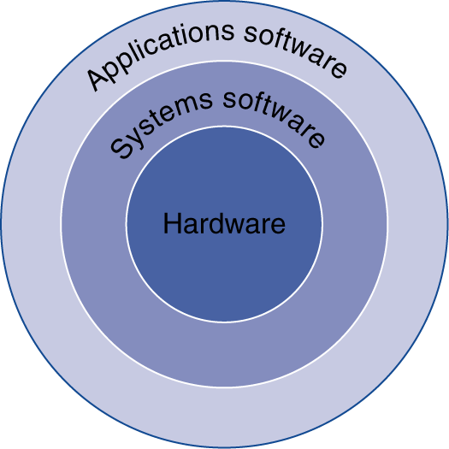
Below Your Program
§1.2 Below Your Program
Application software
Written in high-level language
Java, Python, C, C++
System software
Compiler: translates HLL code to machine code
Ex: GCC
Operating System: service code
Handling input/output
Managing memory and storage
Scheduling tasks & sharing resources
Ex: Linux, Windows
Hardware
Processor, memory, I/O controllers
Ex: Intel i3-7, ARM, DRAM
Notes:
App software (whatapp to banking apps to webrowser)
underlying libraries both kernel/OS and user apps - compilers, s/w that talks to h/w, memory management, process/thread scheduling code, etc.
CPU, DRAM, I/O controllers (PCI)

Slide 14
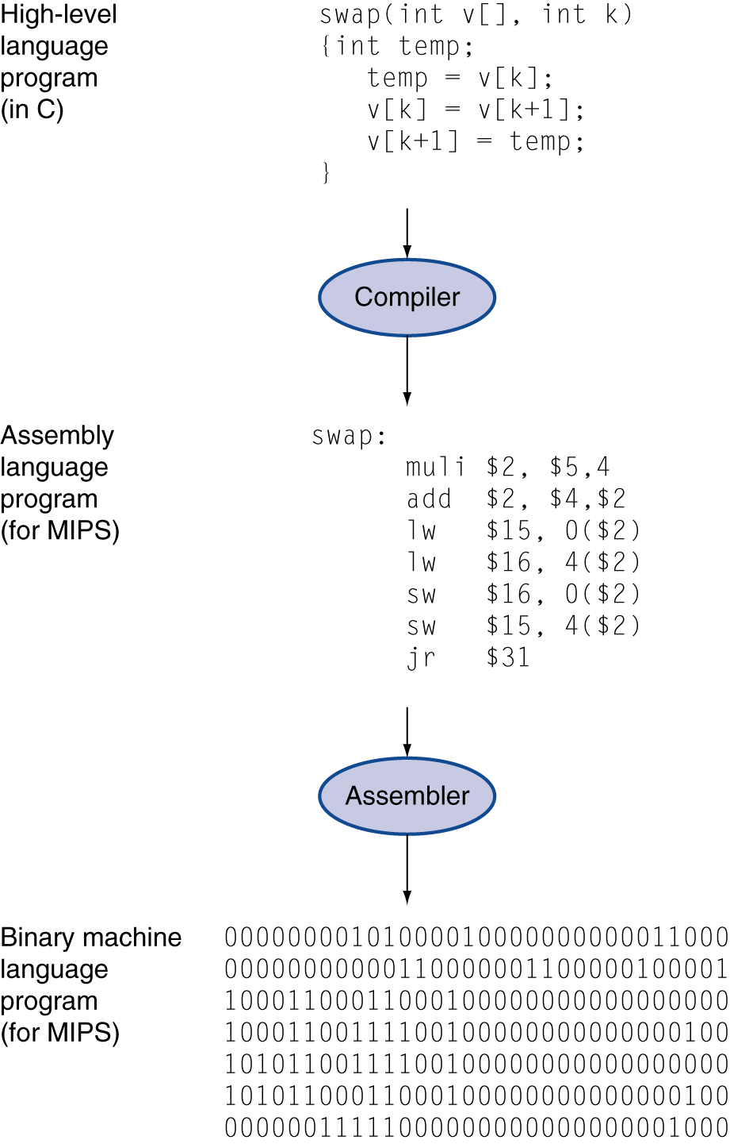
Levels of Program Code
High-level language
Level of abstraction closer to problem domain
Provides for productivity and portability
Assembly language
Textual representation of instructions
Hardware representation
Binary digits (bits)
Encoded instructions and data
Notes:
Computers are slaves to commands
However it understands only 1’s and 0’s – a tedious job for programmers to give instructions in 1’s and 0’s
Like alphabets
So we invented assembler that translates textual instructions to binary
Like dictionary ☺
Assembly language requires programmer to write one line for every instruction, forcing programmer to think like the computer.
Although this is better than binary, still far from the human language, say normal English
Today creation of HLL like c, java, python, are one of great breakthroughs
the creation increased productivity, and
make humans think in a more natural language.
HLL → compilers → assembly language → assembly → binary code ☺

Slide 15
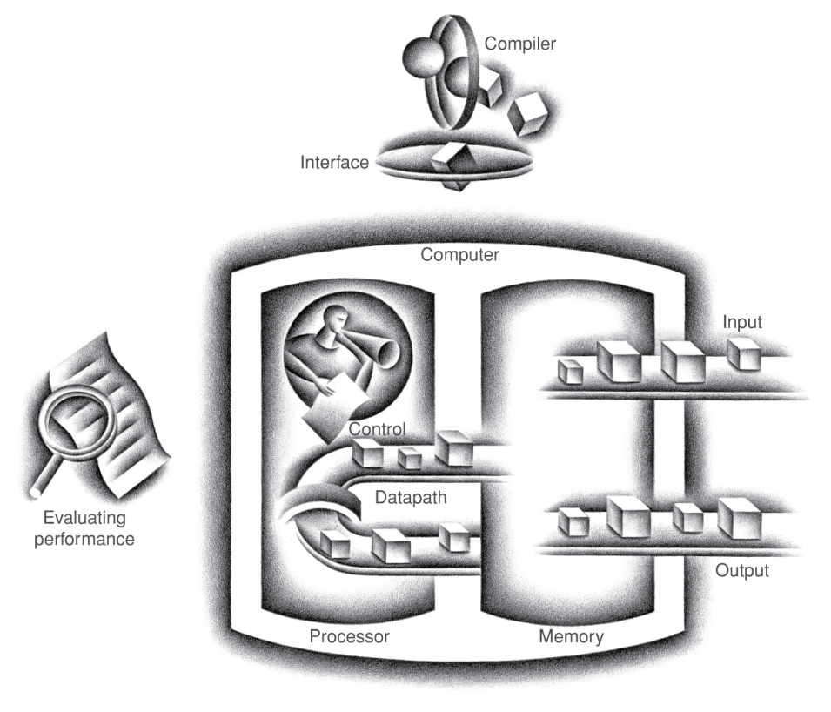
Components of a Computer
Same components for all kinds of computer
Desktop, server, embedded
Input/output includes
User-interface devices
Display, keyboard, mouse
Storage devices
Hard disk, CD/DVD, flash
Network adapters
For communicating with other computers
§1.3 Under the Covers
The BIG Picture
Notes:
Computer do mainly four basic operations are input, output, process and store. They are same for all kinds of computers – laptop to server to mobile to smart bulb.
The processor (CPU) gets instructions from memory (DRAM)
Input writes data to memory (Mouse,keyboard)
Output reads data from memory (Harddisk, Monitor, N/w adapters)
Control sends the signals that determine the operations of the data path, memory, input and output.

Slide 16
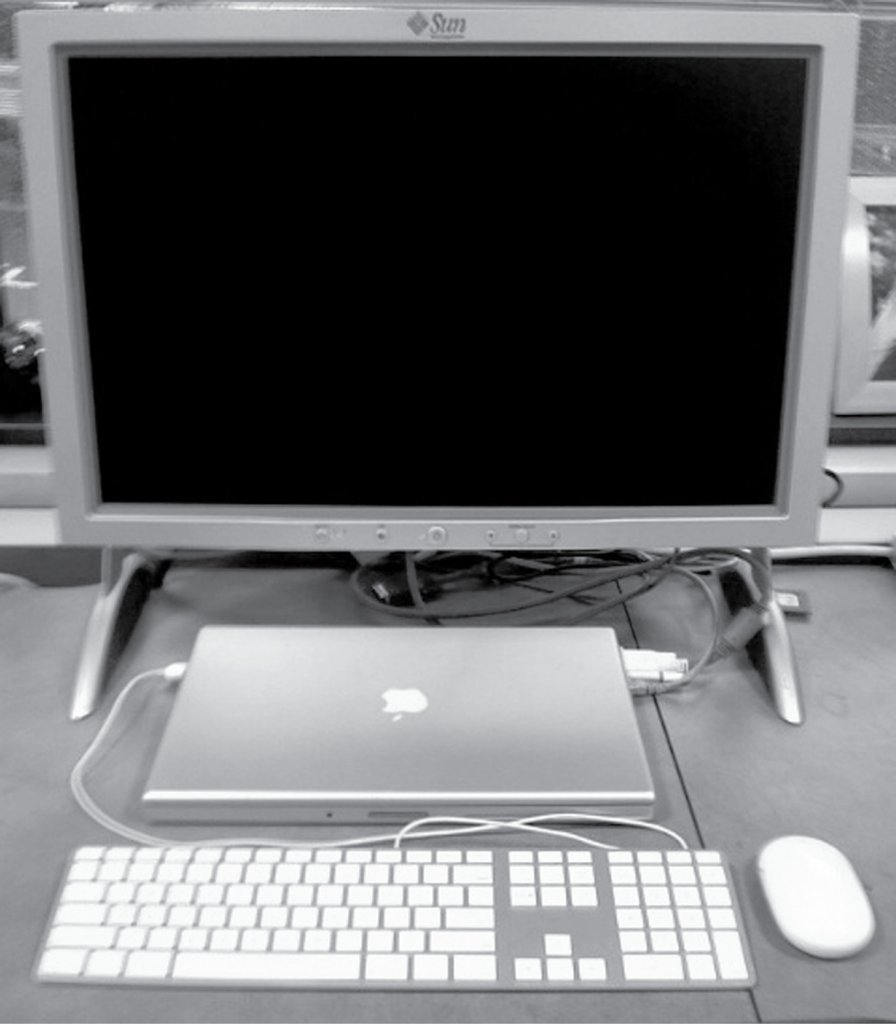
Anatomy of a Computer
Output device
Network cable
Input device
Input device

Slide 17
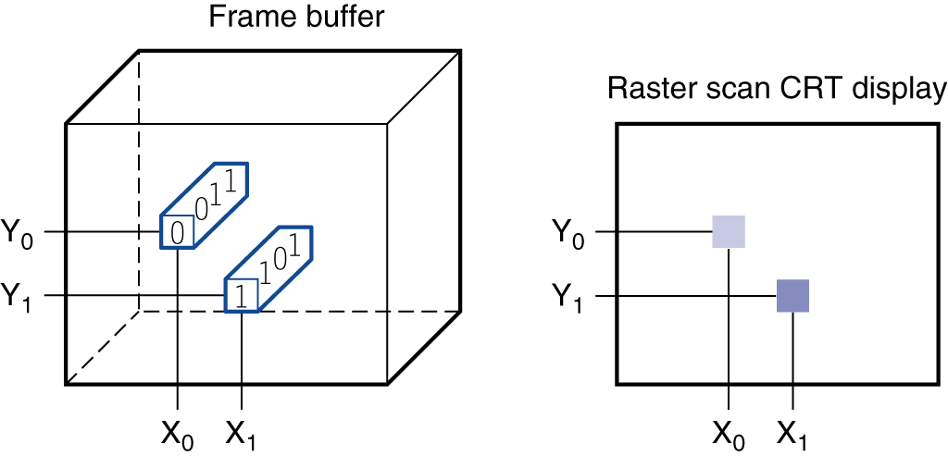
Through the Looking Glass
LCD screen: picture elements (pixels)
Mirrors content of frame buffer memory
Notes:
- 640 * 480, 2560 * 1600 matrix of bits also called pixels
The computer hardware support for graphics consists mainly of a frame buffer, to store the bit map.
The image to be represented onscreen is stored in the frame buffer, and the bit pattern per pixel is read out to the graphics display at the refresh rate.
shows a frame buffer with a simplified design of just 4 bits per pixel.
Pixel x0,y0 contains the bit pattern 0011, which is a lighter shade on the screen than the bit pattern 1101 in pixel x1,y1

Slide 18
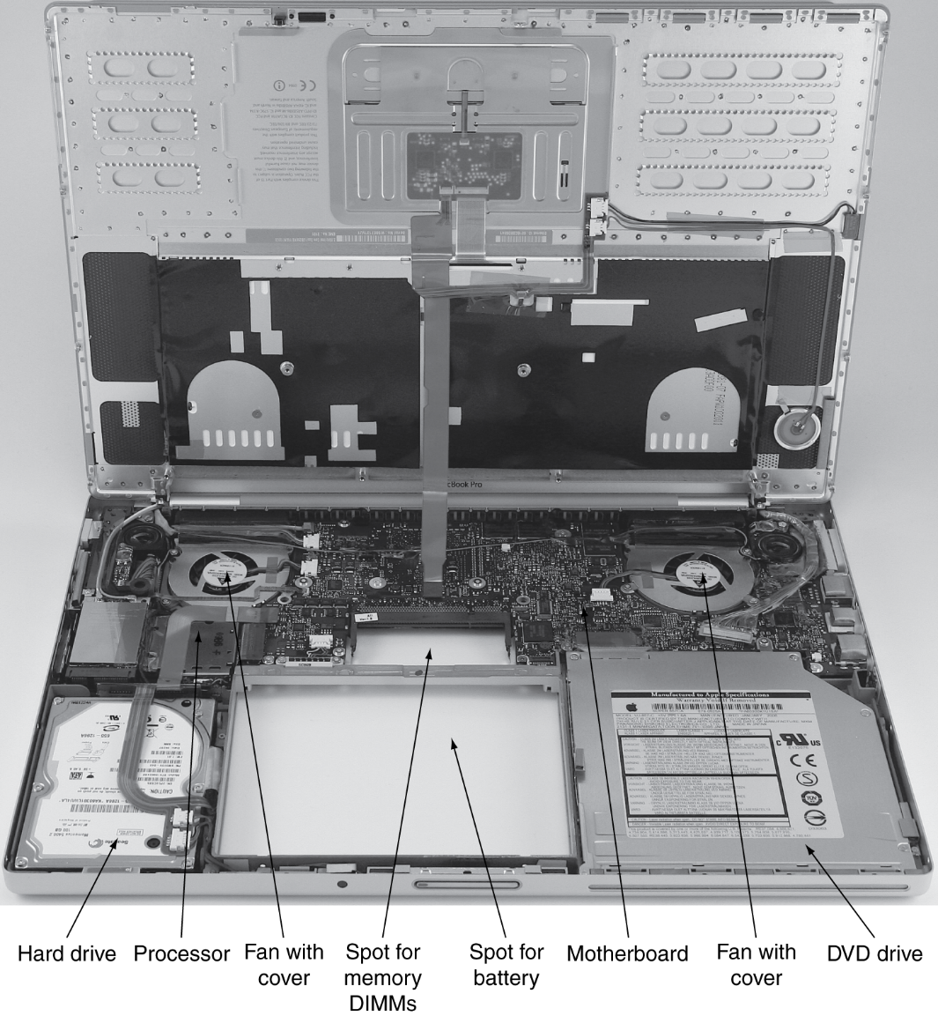
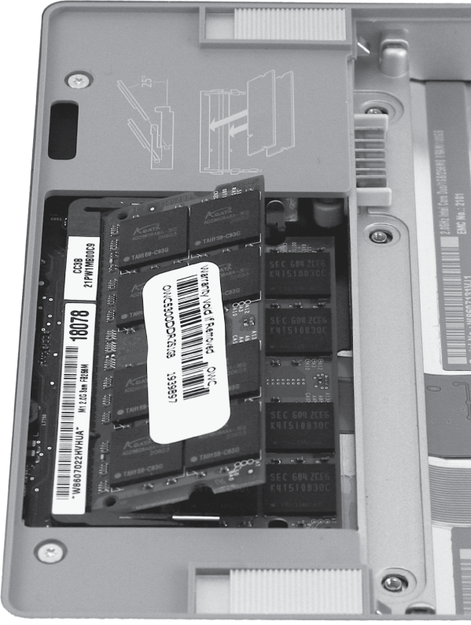
Opening the Box
Notes:
The shiny box with the white label on the lower left is a 100 GB SATA hard disk drive,
and the shiny metal box on the lower right side is the DVD drive.
The hole between them is where the laptop battery would be located.
The small hole above the battery hole is for memory DIMMs. Right figure is a close­up of the DIMMs, which are inserted from the bottom in this laptop.
Above the battery hole and DVD drive is a printed circuit board (PC board), called the motherboard, which contains most of the electronics of the computer. The board is composed of three pieces: the piece connecting to the I/O devices mentioned earlier, the memory, and the processor.
The two shiny circles in the upper half of the picture are two fans with covers.
The processor is the large raised rectangle just below the left fan.

Slide 19
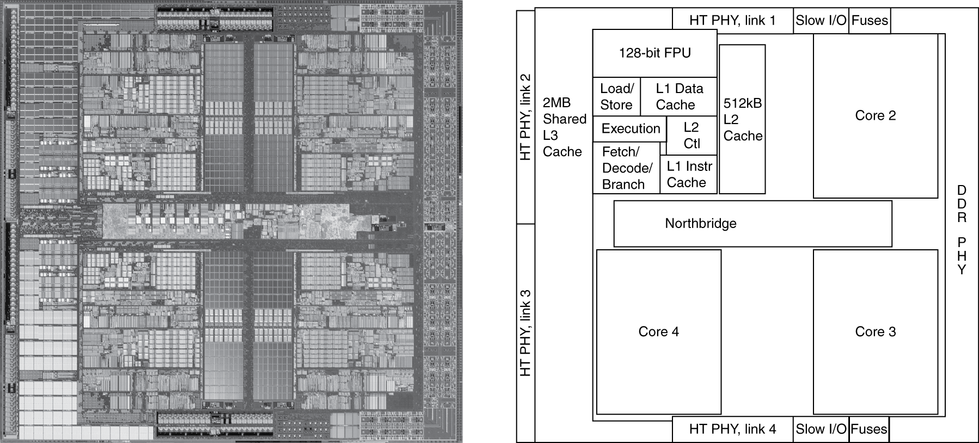
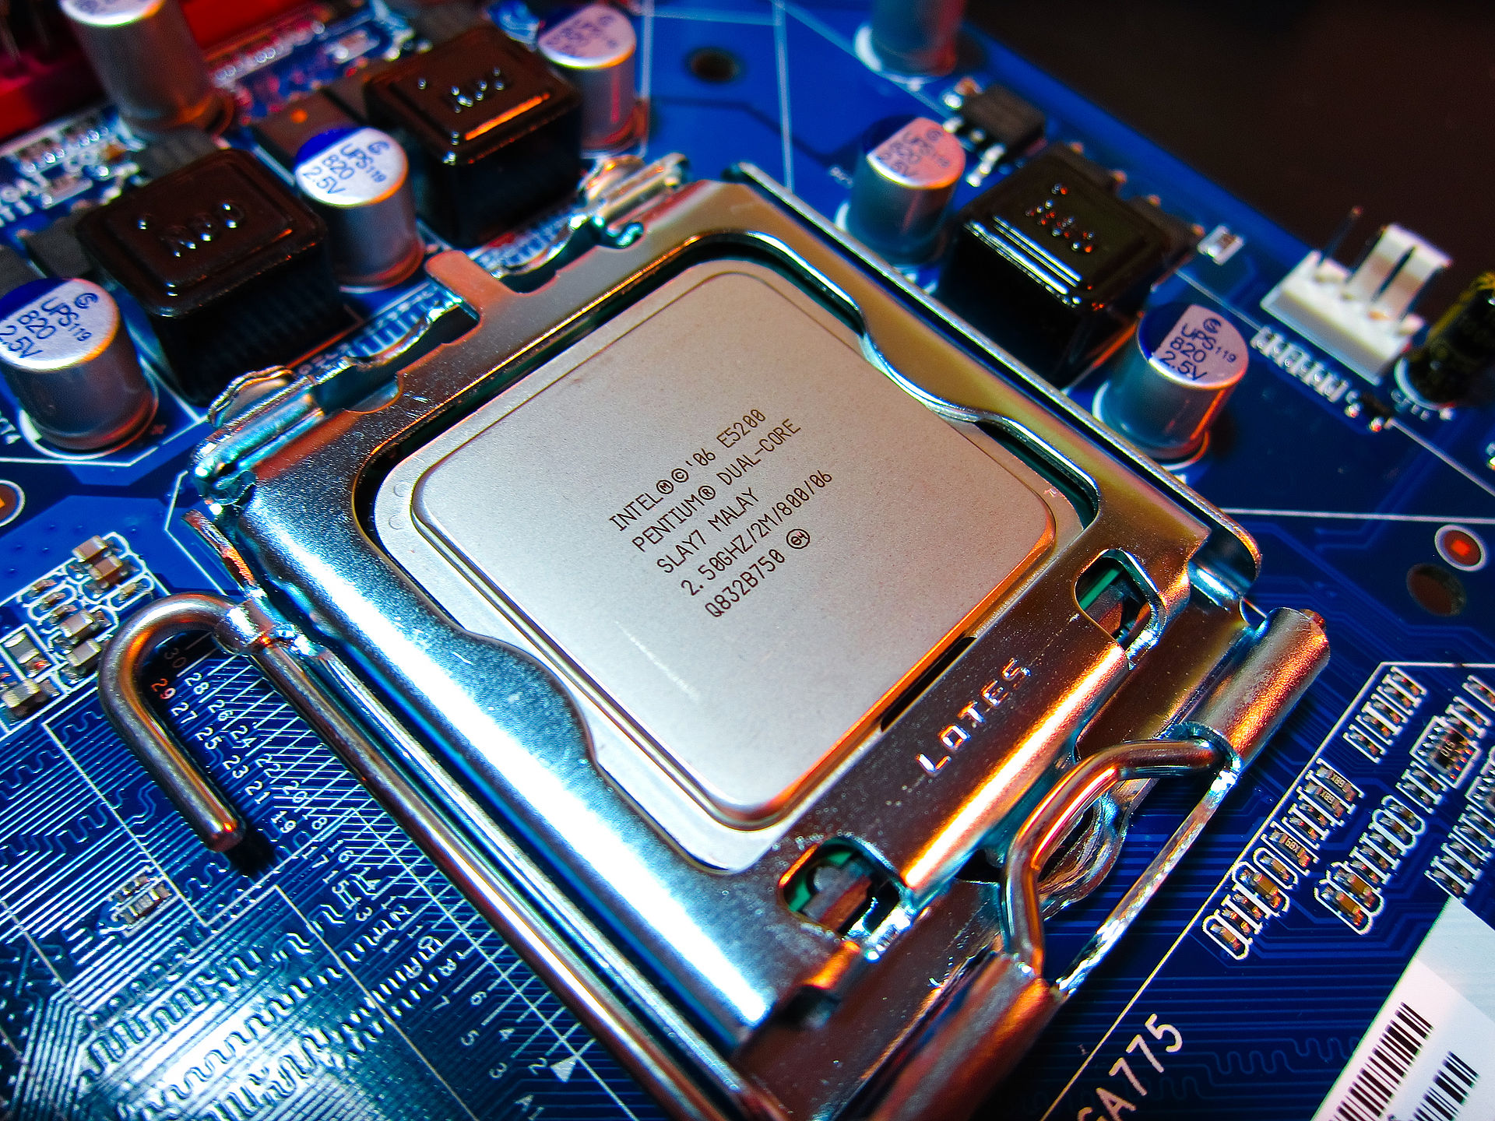
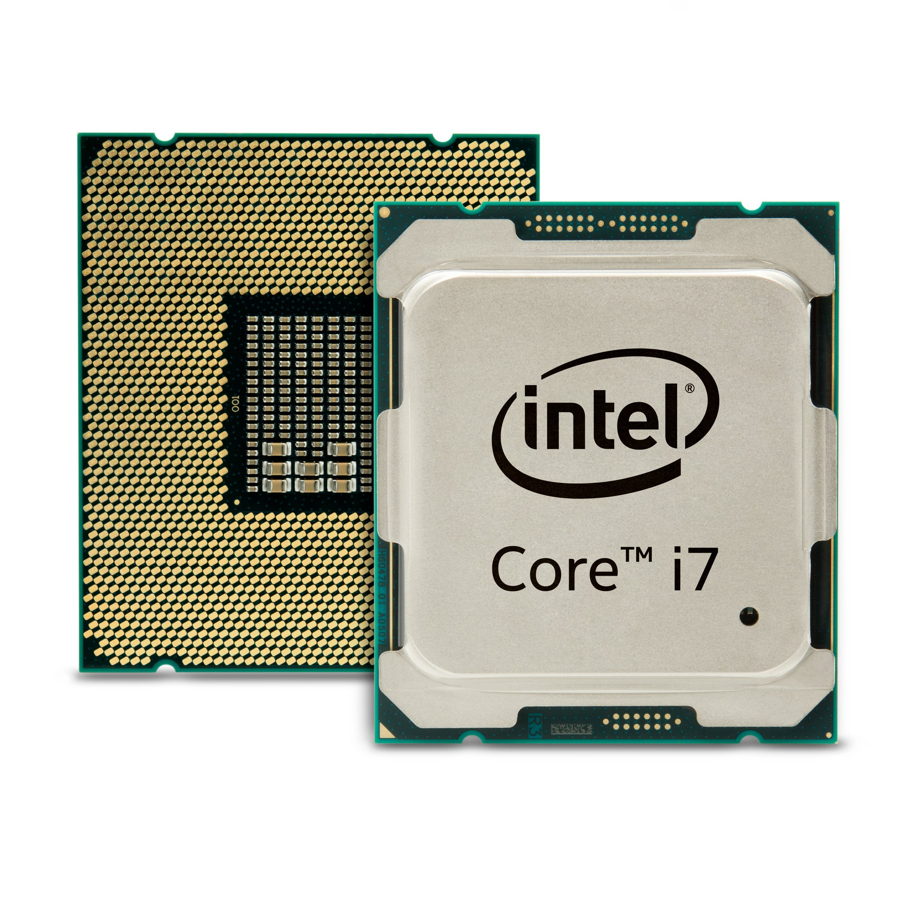
Inside the Processor
AMD Barcelona: 4 processor cores
Notes:
The left­hand side is a microphotograph of the AMD Barcelona processor chip, and the right­hand side shows the major blocks in the processor.
This chip has four processors or “cores”. The microprocessor in the laptop has two cores per chip, called an Intel Core 2 Duo.

Slide 20
Block diagram of computer
Datapath: performs operations
on data
Control: sequences datapath,
memory, ...
Cache memory
Small fast SRAM memory
for immediate access to data
Primary storage – DRAM
Large
Secondary storage – Hard disk
Notes:
The datapath performs the arithmetic operations, and control tells the datapath, memory, and I/O devices what to do according to the wishes of the instructions of the HLL program.
Cache memory consists of a small, fast memory that acts as a buffer for the DRAM memory.
Cache is built using a different memory technology, static random access memory (SRAM). SRAM is faster but less dense, and hence more expensive, than DRAM (more in next lectures)

Slide 21
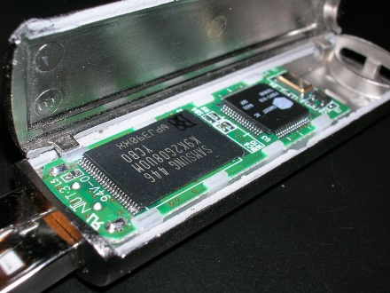
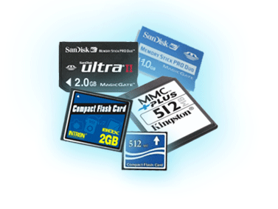
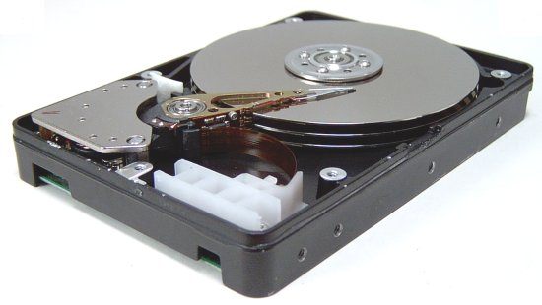
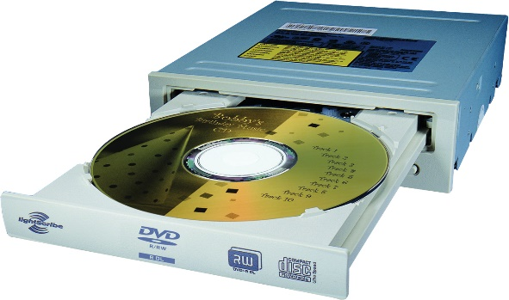
A Safe Place for Data
Volatile main/primary memory
Loses instructions and data when power off
Cache (SRAM), DRAM
Non-volatile secondary memory
Magnetic disk (also hard disk)
Flash memory (also SSD)
Optical disk (CDROM, DVD)
Notes:
volatile memory/main memory used to hold data and programs while they are running and
this nonvolatile memory/ secondary memory used to store data and pro­grams between runs
Flash memory, a nonvolatile semiconduc­tor tor memory, is used instead of disks in mobile devices such as cell phones and is increasingly replacing disks in music players and even laptops.
Access times for magnetic disks are much slower than for DRAMs: disks typically take 5–20 milliseconds, while DRAMs take 50–70 nanoseconds—making DRAMs about 100,000 times faster.
Thus, there are three primary differences between magnetic disks and main memory: disks are nonvolatile because they are magnetic; they have a slower access time because they are mechanical devices; and they are cheaper per gigabyte because they have very high storage capacity at a modest cost.
Many have tried to invent a technology cheaper than DRAM but faster than disk to fill that gap, but many have failed.
Flash memory, however, is a serious challenger. This semiconductor memory is nonvolatile like disks and has about the same bandwidth, but latency is 100 to 1000 times faster than disk.

Slide 22
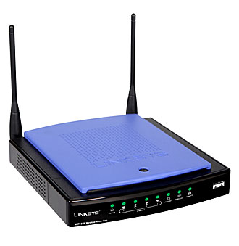
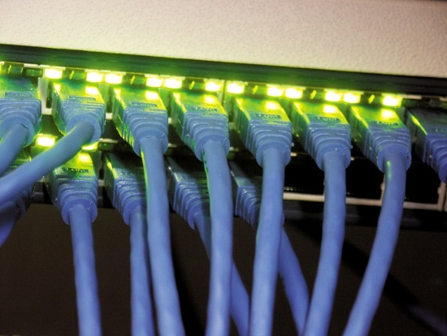
Networks
Communication and resource sharing
Local area network (LAN): Ethernet
Within a building
Wide area network (WAN: the Internet)
Wireless network: WiFi, Bluetooth

Slide 23
Networks enable compute and storage at massive scales
The network has thousands of switches and millions of links
(Datacenters built by Google, facebook, Amazon, MS..)
Rack switch
Cluster switch
30+ racks
Server
80 servers
NIC: 10Gbps
CPUs : 64
DRAM: 16GB, 100ns
Disk: 2TB, 10ms
Bandwidth: 800Gbps
CPUs: 5K
DRAM: 1TB, 300us
Disk: 160TB, 11ms
Bandwidth: 24Tbps
CPUs : 153K
DRAM: 30TB, 500us
Disk: 4.80PB, 12ms
Reference: Jeff Dean. Designs, Lessons and Advice from Building Large Distributed Systems.

Slide 24
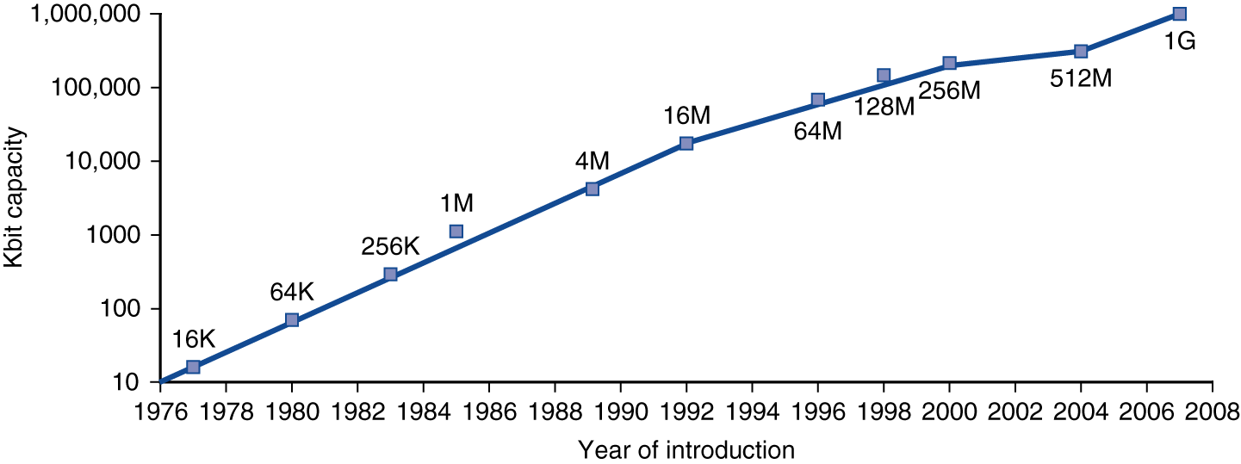
Technology Trends
Electronics technology continues to evolve
Increased capacity and performance
Reduced cost
DRAM capacity
Year | Technology | Relative performance/cost
1951 | Vacuum tube | 1
1965 | Transistor | 35
1975 | Integrated circuit (IC) | 900
1995 | Very large scale IC (VLSI) | 2,400,000
2005 | Ultra large scale IC | 6,200,000,000
Notes:
Moore’s law -- that the number of transistors on a microchip doubles every two years, though the cost of computers is halved.
This table estimates relative performance per unit cost for each technology
A transistor is simply an on/off switch controlled by electricity
The IC combine dozens to hundreds of transistors into a single chip
VLSI : hundreds to millions
The DRAM shows the growth in DRAM capacity since 1977 - quadrapuled capacity every 3 year

Slide 25
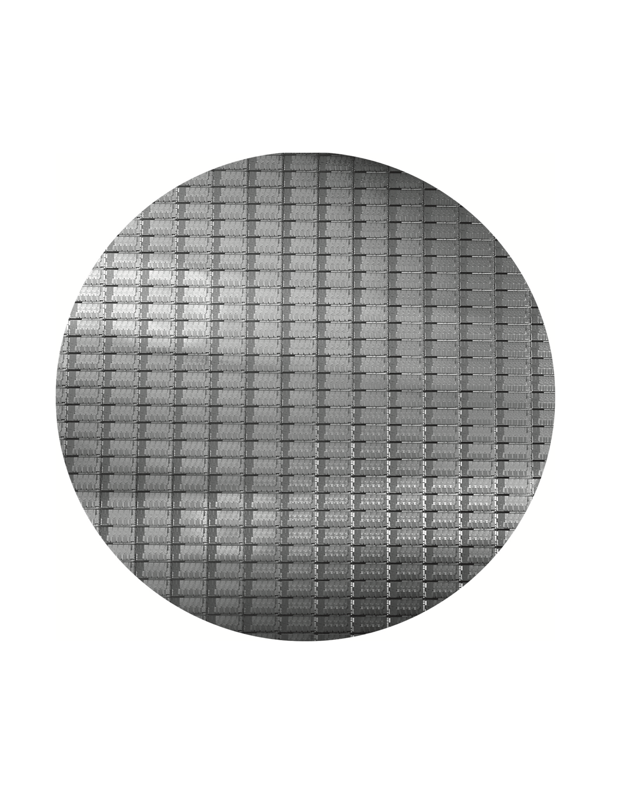
Intel core i7
300mm (12 inch) wafer
100% yields = 280 chips, 32nm technology
Notes:
The number of dies on this 300 mm (12 inch) wafer at 100% yield is 280 chips/dies, each 20.7 by 10.5 mm.
This die uses a 32-nanometer technology, which means that the smallest features are approximately 32 nm in size (e.g., transistor size)

Slide 26
Integrated Circuit Cost
Nonlinear relation to area and defect rate
Wafer cost and area are fixed
Defect rate determined by manufacturing process
Die area determined by architecture and circuit design
Notes:
- The cost of an integrated circuit rises quickly as the die size increases, due both to the lower yield and the smaller number of dies that fit on a wafer.
The first equation is straightforward to derive.
The second is an approximation, since it does not subtract the area near the border of the round wafer that cannot accommodate the rectangular dies
The final equation is based on empirical observations of yields at integrated circuit factories, with the exponent related to the number of critical processing steps.

Slide 27
Defining Performance
§1.4 Performance
Which airplane has the best performance?
Notes:
How do you define performance?
speed? highest cruising speed ➔ concorde
range? longest range → DC-8
Capacity? Largest capacity → Boeing 747
Which is faster?:
For one passenger? → concorde is the winner
For many passengers? → boeing 747 is the winner (#passenger x mph)
Running a same program on two diff desktop comp? which is faster?
Desktop computer that gets job done first
Running a datacenter with several serveres running jobs submitted by webusers
fast datacenter is the one which complets most jobs during a day

Slide 28
Response Time and Throughput
Response time
How long it takes to do a task
Throughput
Total work done per unit time
e.g., tasks/transactions/… per hour
How are response time and throughput affected by
Replacing the processor with a faster version?
Adding more processors?
We’ll focus on response time for now…
Notes:
As an individual computer user, you are interested in reducing response time—the time between the start and completion of a task—also referred to as a execution time
Datacenter managers are often interested in increasing throughput or bandwidth—the total amount of work done in a given time.
Hence, in most cases, we will need different performance metrics to benchmark personal mobile devices, which are more focused on response time, versus servers, which are more focused on throughput.
How are time and throughput affected by
replacing faster processor
adding more processor
Ans: Decreasing response time almost always improves throughput. Hence, in case 1, both response time and throughput are improved. In case 2, no one task gets work done faster, so only throughput increases.
when it comes In comp perf, we primarliy focus on response time..

Slide 29
Relative Performance
Define Performance = 1/Execution Time
“X is n time faster than Y”
Example: time taken to run a program
10s on A, 15s on B
Execution Time_{B} / Execution Time_{A} = 15s / 10s = 1.5
So A is 1.5 times faster than B
Notes:
To maximize performance, we want to minimize response time or execution time for some task.
So performance is inverse of execution time
To compare performance of two computers, e..g, how many times X is fast compared to Y, to get this we take the ratio: perf-x/perf-y or exectime-y/exectime-x
See example…

Slide 30
Measuring Execution Time
Elapsed time
Total response time, including all aspects
Processing, I/O, OS overhead, idle time
Determines system performance
CPU time
Time spent processing a given job
Discounts I/O time, other jobs’ shares
Comprises user CPU time and system CPU time
Different programs are affected differently by CPU and system performance
Notes:
Program execution time is measured in seconds per program.
Response time or elapsed time includes all aspects – CPU processing, disk accesses, memory accesss, I/O delays, OS overhead
We want to distinguish between the elapsed time and the time over which the processor is working on our behalf, called CPU time (eg., no waiting time for I/O or running other programs)
CPU time can be further divided into CPU time spent on program, called user CPU time and the CPU time spend in the OS performing tasks on behalf of the program, called system CPU time
CPU performance: refer to user CPU time
System performance: refer to elapsed time on an unloaded system
We will focus on CPU performance in this chapter

Slide 31
CPU Clocking
Operation of digital hardware governed by a constant-rate clock
Clock period
Clock (cycles)
Data transfer and computation
Update state
Clock period: duration of a clock cycle
e.g., 250ps = 0.25ns = 250×10^{–12}s
Clock frequency (rate): cycles per second
e.g., 4.0GHz = 4000MHz = 4.0×10⁹Hz
Notes:
- Although time is what we care about, computer designers use a measure that relates to how fast the hardware can perform basic functions.
All computers are constructed using a clock that determines when events take place in the hardware
These discrete time intervals are called clock cycles or clock periods or clock ticks- the time for one clock period, usually of the processor clock, which runs at a constant time
Clock period: length of each clock cycle
Clock frequence (rate): #cycles per second – inverse of clock period

Slide 32
CPU Time
Performance improved by
Reducing number of clock cycles
Increasing clock rate
Hardware designer must often trade off clock rate against cycle count
Notes:
- Users and designers often examine performance using different metrics. If we could relate these different metrics, we could determine the effect of a design change on the performance as experienced by the user.
CPU performance = CPU execution time → relates to basic metrics – clock cycles and cycle time
A hardware designer can improve performance either by reducing the #clock cycles required for a program or length of the clock cycle (cycle time)
Later chapters discuss the tradeoff between cycle rate vs cycle count

Slide 33
CPU Time Example
Computer A: 2GHz clock, 10s CPU time
Designing Computer B
Aim for 6s CPU time
Can do faster clock, but causes 1.2 × clock cycles
How fast must Computer B clock be?
Notes:
Our favorite program runs in 10 seconds on computer A, which has a 2 GHz clock. We are trying to help a computer designer build a computer, B, which will run this program in 6 seconds. The designer has determined that a substantial increase in the clock rate is possible, but this increase will affect the rest of the CPU design, causing computer B to require 1.2 times as many clock cycles as computer A for this program. What clock rate should we tell the designer to target?

Slide 34
Instruction Count and CPI
Instruction Count for a program
Determined by program, ISA and compiler
Average cycles per instruction
Determined by CPU hardware
If different instructions have different CPI
Average CPI affected by instruction mix
Notes:
We haven’t discusses how many instructions needed for the program
Compiler generates instructions to execute, and the computer had to execute the instructions (C-progam → Assembly instructions → Instructions in byte code)
So the execution time depends on the #instructions in a program
CPU clock cycles = instruction count x average clock cycles per instruction (CPI)
Each instruction may take different number of clock cycles -- Same instruction take different time on different hardware implementations, but the instruction count could be the same.
therefore, CPU time= instruction count x CPI x clock cycle time or (instruction count x CPI) / clock rate
These formulas are particularly useful because they separate the three key factors that affect performance. We can use these formulas to compare two different implementations or to evaluate a design alternative if we know its impact on these three parameters.

Slide 35
CPI Example
Computer A: Cycle Time = 250ps, CPI = 2.0
Computer B: Cycle Time = 500ps, CPI = 1.2
Same ISA
Which is faster, and by how much?
A is faster…
…by this much

Slide 36
CPI in More Detail
If different instruction classes take different numbers of cycles
Weighted average CPI
Relative frequency

Slide 37
CPI Example
Alternative compiled code sequences using instructions in classes A, B, C
Class | A | B | C
CPI for class | 1 | 2 | 3
IC in sequence 1 | 2 | 1 | 2
IC in sequence 2 | 4 | 1 | 1
Sequence 1: IC = 5
Clock Cycles = 2×1 + 1×2 + 2×3 = 10
Avg. CPI = 10/5 = 2.0
Sequence 2: IC = 6
Clock Cycles = 4×1 + 1×2 + 1×3 = 9
Avg. CPI = 9/6 = 1.5

Slide 38
Performance Summary
The BIG Picture
Performance depends on
Algorithm: affects IC, possibly CPI
Programming language: affects IC, CPI
Compiler: affects IC, CPI
Instruction set architecture: affects IC, CPI, T_{c}
Notes:
- The algorithm determines the number of source program instructions executed and hence the number of processor instructions executed. The algorithm may also affect the CPI, by favoring slower or faster instructions. For example, if the algorithm uses more divides, it will tend to have a higher CPI.
- The programming language certainly affects the instruction count, since statements in the language are translated to processor instructions, which determine instruction count. The language may also affect the CPI because of its features; for example, a language with heavy support for data abstraction (e.g., Java) will require indirect calls, which will use higher CPI instructions.
- The efficiency of the compiler affects both the instruction count and average cycles per instruction, since the compiler determines the translation of the source language instructions into computer instructions. The compiler’s role can be very complex and affect the CPI in complex ways.
- The instruction set architecture affects all three aspects of CPU performance, since it affects the instructions needed for a function, the cost in cycles of each instruction, and the overall clock rate of the processor.

Slide 39
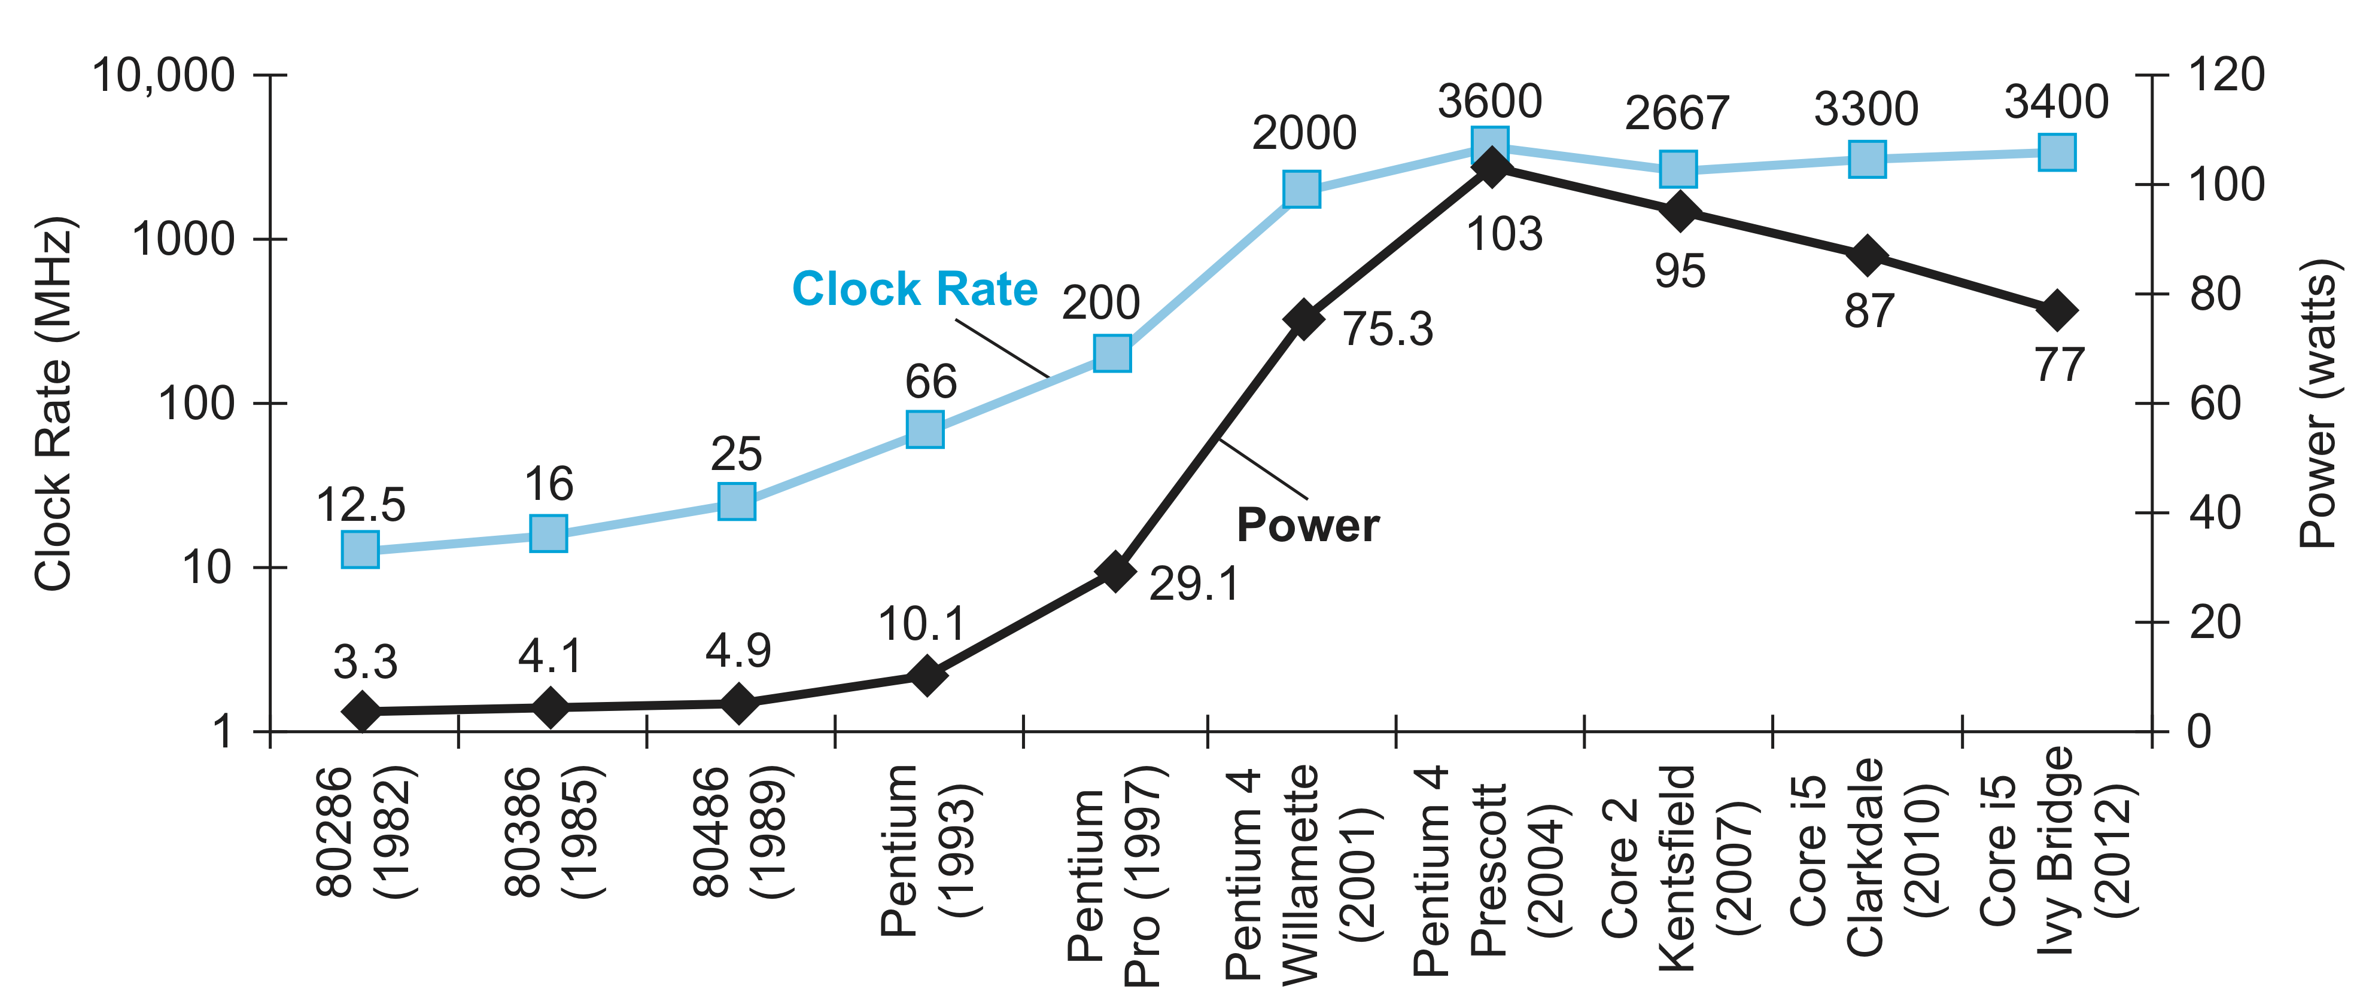
Power Trends
§1.5 The Power Wall
In CMOS IC technology
×30
5V → 1V
×1000
Notes:
Shows increase in clock rate and power of eight generations of intel processors
The Pentium 4 made a dramatic jump in clock rate and power but less so in performance. The Prescott thermal problems led to the abandonment of the Pentium 4 line. The Core 2 line reverts to a simpler pipeline with lower clock rates and multiple processors per chip. The Core i5 pipelines follow in its footsteps.
Power and clock rate are corelated
The reason for slowing down is we ran into practical power limit for cooling commodity processors
Battery life can trump performance in the personal mobile devices (laptop, mobiles)
Architects of servers, try to reduce costs of powering and cooling 100k servers as the costs are high at this scale
Like CPU time for measuring performance, joules (joules/sec) is a better measure than a power rate like watts
CMOS is the dominant technology for Integrated circuits in processor
For CMOS, primary source of energy consumption is so-called dynamic energy – which is energy consumed when transistors switch states from 0 to 1 and viceversa
Energy is proportional to capacitive load x voltage^
Power required per transistor is: power is proportional to capacitive load x voltage^2 x frequency switched
Frequency switched is a function of clock rate
Capacitive load per transistor is a function of both #transistors connected to output (fanout) and the technology
How clock rate grow by a factor of 1000 while power grew by only a factor of 30?
Energy and thus power can be reduced by lowering the voltage, possible with new generation of technology
Since power is a function of the voltage squared, it worked
Voltage was reduced about 15% per generation, In 20 years, voltages have gone from 5V to 1V, power increase is only 30 times

Slide 40
Reducing Power
Suppose a new CPU has
85% of capacitive load of old CPU
15% voltage and 15% frequency reduction
The power wall
We can’t reduce voltage further
We can’t remove more heat
How else can we improve performance?
Notes:
Suppose we developed a new, simpler processor that has 85% of the capacitive load of the more complex older processor. Further, assume that it has adjustable voltage so that it can reduce voltage 15% compared to processor B, which results in a 15% shrink in frequency. What is the impact on dynamic power?
Hence, the new processor uses about half the power of the old processor

Slide 41
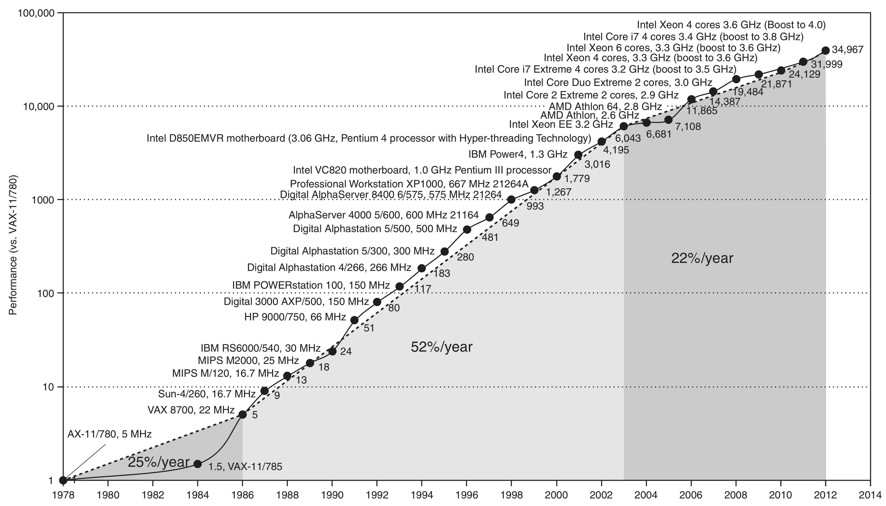
Uniprocessor Performance
§1.6 The Sea Change: The Switch to Multiprocessors
Constrained by power, instruction-level parallelism, memory latency
Notes:
Prior to the mid-1980s, processor performance growth was largely technology- driven and averaged about 25% per year.
The increase in growth to about 52% since then is attributable to more advanced architectural and organizational ideas. The higher annual performance improvement of 52% since the mid-1980s meant performance was about a factor of seven higher in 2002 than it would have been had it stayed at 25%.
Since 2002, the limits of power, available instruction-level parallelism, and long memory latency have slowed uniprocessor performance recently, to about 22% per year.

Slide 42
Multiprocessors
Multicore microprocessors
More than one processor per chip
Requires explicitly parallel programming
Compare with instruction level parallelism
Hardware executes multiple instructions at once
Hidden from the programmer
Hard to do
Programming for performance
Load balancing
Optimizing communication and synchronization
Notes:
- In the past, programmers could rely on innovations in hardware, architecture, and compilers to double performance of their programs every 18 months without having to change a line of code. Today, for programmers to get significant improvement in response time, they need to rewrite their programs to take advantage of multiple processors.
a “quadcore” microprocessor is a chip that contains four processors or four cores.
Two types of parallelism:
Instruction-level parallelism already used heaviliy in uniprocessors (no changes are required to programs, hidden from the programmer)
Multicore/multiprocessor parallelism (changes required to programs to improve performance, programmers should rewrite their programs for multiprocessors)
Parallel programming, hard because
increases difficulty of programming, divide application so each processor get same amount of work to do, overhead of scheduling and coordination

Slide 43
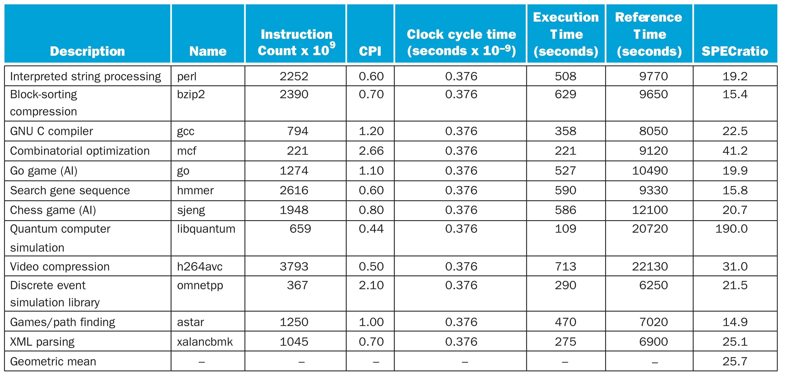
Intel core i7 2.66GHz performance
Notes:
- Benchmark – A program selected for use in comparing computer performance
- SPEC: System performance evaluation cooperative – created standard sets of benchmarks for modern computer systems
- Table: Execution time is the product of the three factors in this table: instruction count in billions, clocks per instruction (CPI), and clock cycle time in nanoseconds. SPECratio is simply the reference time, which is supplied by SPEC, divided by the measured execution time. The single number quoted as SPECINTC2006 is the geometric mean of the SPECratios.

Slide 44
Concluding Remarks
Cost/performance is improving
Due to underlying technology development
Execution time: the best performance measure (IC x CPI x Clock period)
Power is a limiting factor
Use parallelism to improve performance
§1.9 Concluding Remarks
Notes:
it’s a safe bet that cost/performance will be much better than they are today.
using the execution time of real programs as the metric is a reliable method of determining and reporting performance
Conserving power while trying to increase performance has forced the hardware industry to switch to multicore microprocessors, thereby forcing the software industry to switch to programming parallel hardware. Parallelism is now required for performance.

